Slide 1
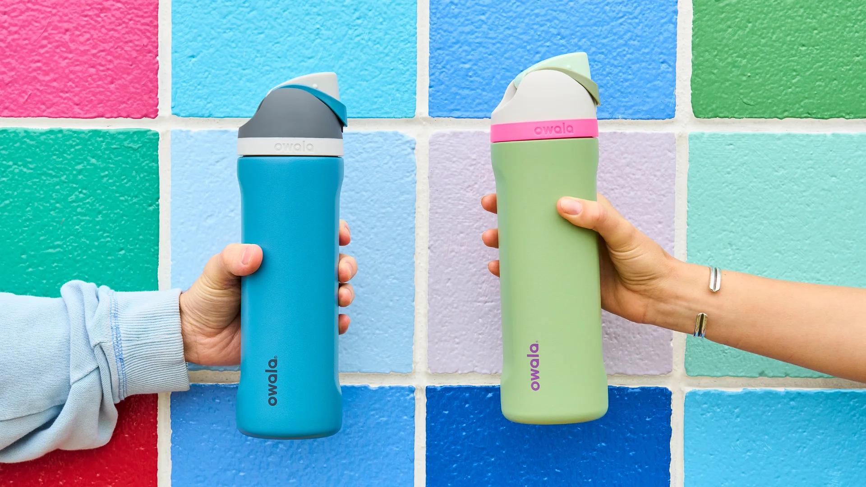
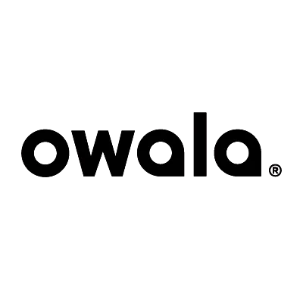

Slide 2
Hi. We make water bottles.
Why? Well, we're a motley crew of dreamers and designers who live by a simple creed: "Do more of what you love."
And we love designing things that make life a little bit easier and a heckuva a lot more enjoyable.
So we asked ourselves with so many different kinds of water bottles out there, why do 3 out of 4 people still suffer from chronic dehydration? We all know that when we’re dehydrated we look and feel like crap. Which means we’re living more like zombies than human beings. And, last we checked, zombies are all work and no play.
We took a long hard look and found that most water bottles are either overkill or underwhelming. For starters, do you really need a water bottle built for climbing Mt. Everest for your desk at work? Or when you’re just out and about? Or sweatin’ to Post Malone at the gym? You need a water bottle designed to be your sidekick, not your sherpa.
So we rolled up our sleeves and got to work. Three years and some change later, we created what we believe to be the finest water bottles in all the land. Water bottles designed to help you do more of what you love. So, what are you waiting for? Go forth and carpe the diem—hydrated like a boss.
:

Slide 3
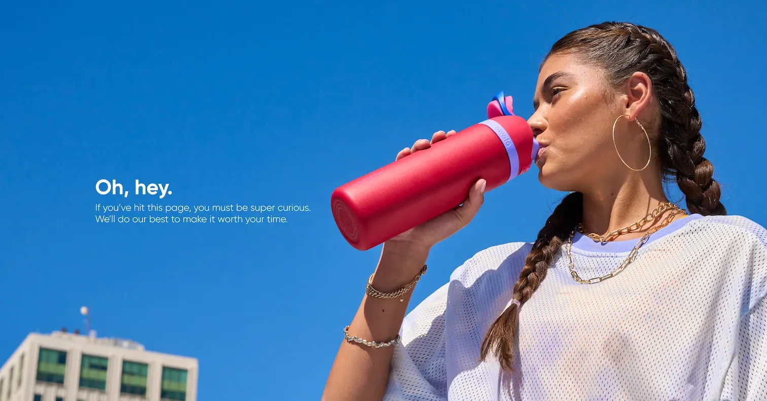
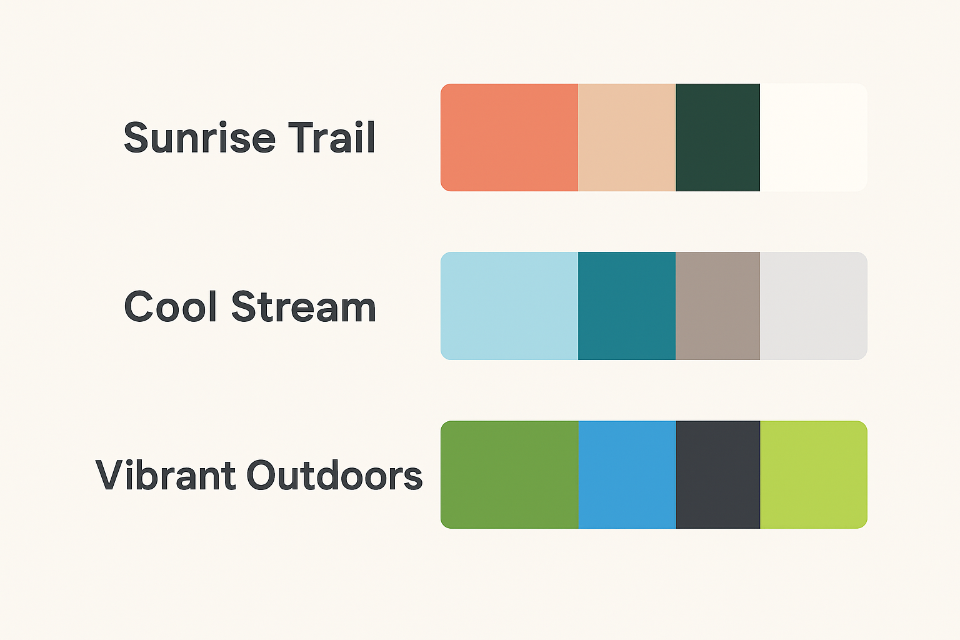

Names:
-Olo
-OQUA
Mission Statement:
To inspire people to explore more, move more, and live more—powered by hydration that supports every adventure
Font Family:
Olo (Lazy dog)
OQUA (Museo Moderno)
Color Swatch:

Slide 4
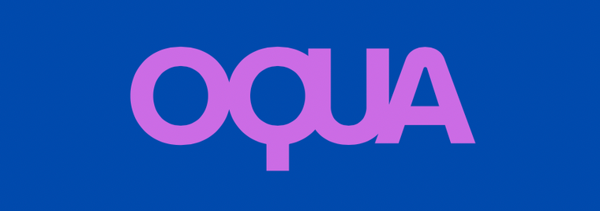
Logos:
OlO
Taglines:
Taglines:
“Olo — Fuel Your Flow.”
“Oqua — Water, Elevated.”
“Olo – Drink Better. Go Further.”
“Oqua — Hydrate Happier.”
“Olo – Sip Sustainably.”
“Oqua — Fuel the Movement.”

Slide 5
Owen: A
Manali: B
Tracy: C
21
Undergraduate student at the University of Pittsburgh
Political Science major
Male
21
Undergraduate student at the University of Pittsburgh
Psychology major
Female
56
Preschool Teacher
Female
Mother

Slide 6
Partipants Insight:
Like:
The earthy colors of the first design
The font and different contrasting colors of the font of the first design
Enjoyed mission statement, “explore more, move more, and live more” – thought it was very realistic for a waterbottle company
The design paired well with the taglines, specifically OLO and “Olo – Drink Better. Go Further.”
Did not like:
The colors “clash” in design 1
The OQUA design is too close to the original Owala design and color palette
OQUA is corny.

Slide 7
Final:
OlO
To inspire people to explore more, move more, and live more—powered by hydration that supports every adventure
“Olo – Drink Better. Go Further.”
Font:
Olo (Lazy dog)

Slide 8
UX Research Method and Purpose:
One style sheet with the rebrand info on it.
Three types of questions
Visceral: Initial reaction
Behavioral: How something makes you feel
Reflective: decision making
Three interviewees
Each will answer questions to create feedback

Slide 9
Appendix
A. Owen
https://drive.google.com/file/d/1_rlut0_vtOtlCjsbbkpHZuZuPyvzfMN/view?usp=sharing
B. Manali
https://drive.google.com/file/d/1FGtz1_paq7tlPpvS6T19G3VDmshLbus/view?usp=sharing
C.Tracy
https://drive.google.com/file/d/197WQHjJzPnUt_FOA_lIFj52U1R7DDRS/view?usp=sharing
Interview Script
https://docs.google.com/document/d/1309KSpHX7WBDi2T6Fg0HWjPw4KUsSqM8M4a8lT5iwNc/edit?usp=sharing

